Slide 1
Coflow Survey
Reporter: 刘子凡

Slide 2
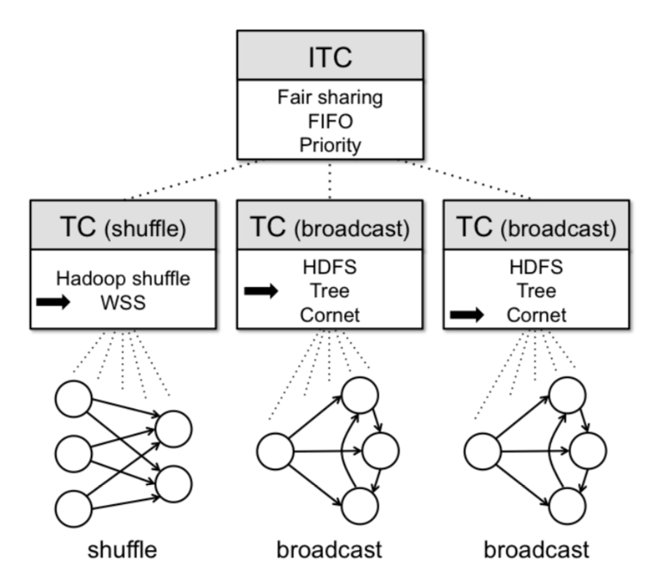
Managing Data Transfers in Computer Clusters with Orchestra
M. Chowdhury
SIGCOMM 2011
FIFO

Slide 3
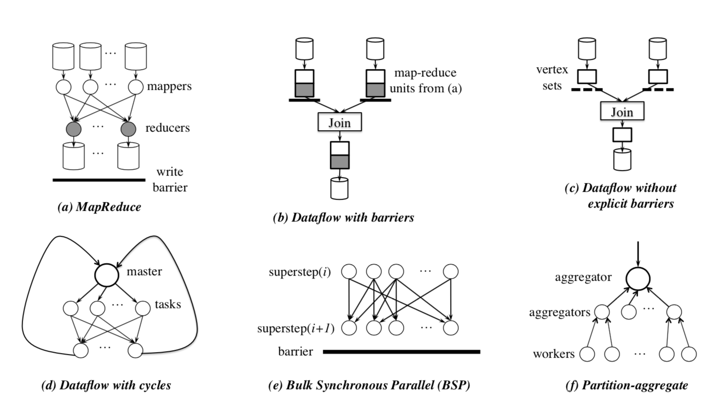
Coflow: a networking abstraction for cluster applications
M. Chowdhury
HotNets 2012
提出coflow概念

Slide 4
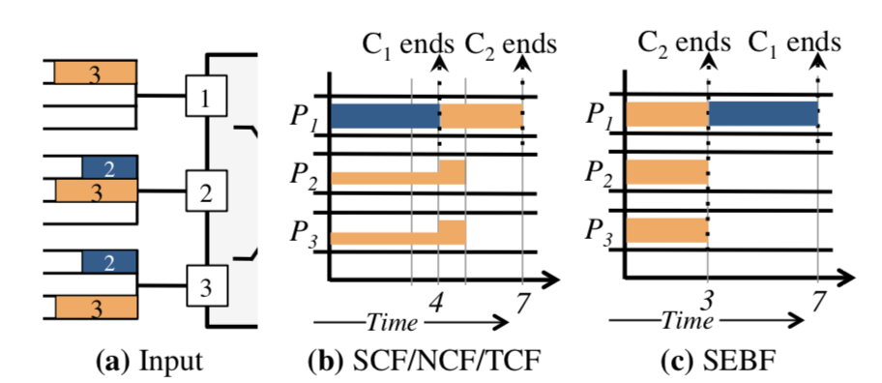
Minimize CCT
Efficient Coflow Scheduling with Varys
M. Chowdhury
SIGCOMM 2014
inter-coflow SEBF
Intra-coflow MADD

Slide 5
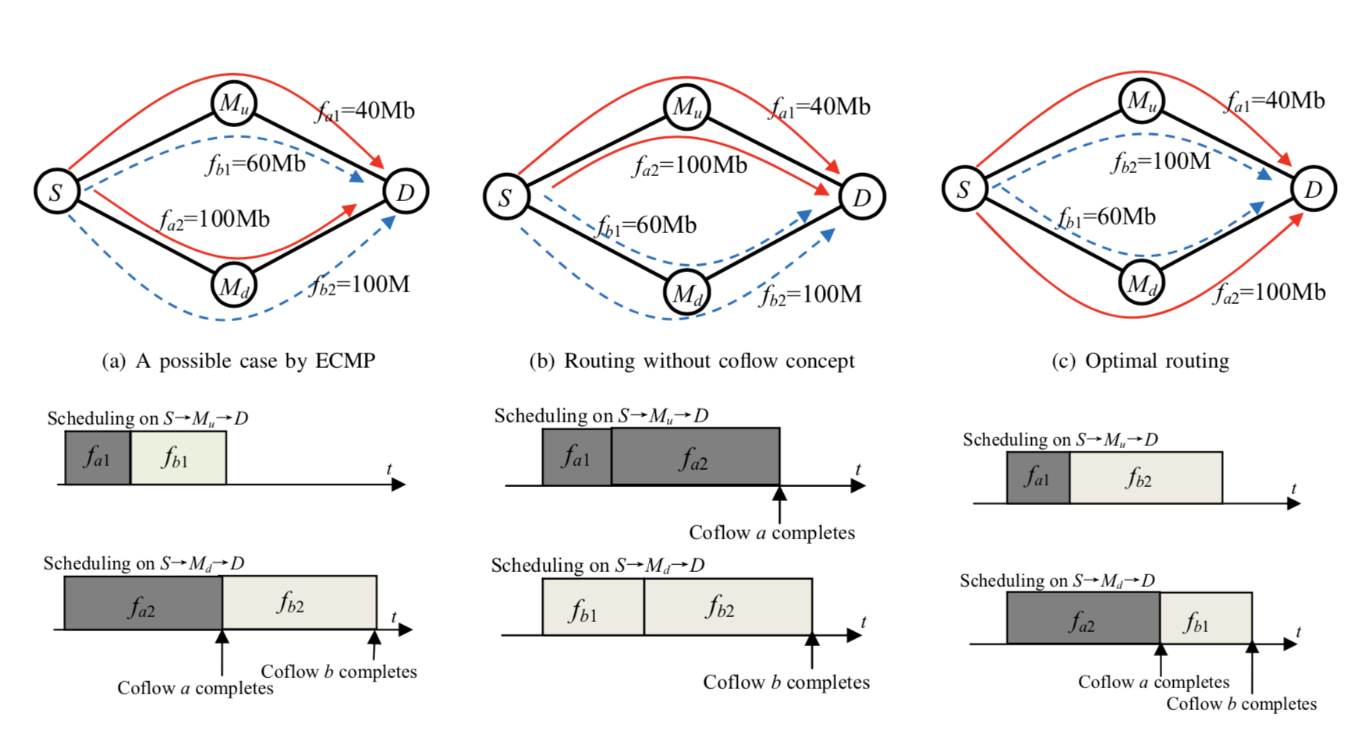
Routing
Rapier: Integrating routing and scheduling for coflow-aware data center networks
Yangming Zhao, Kai Chen, Wei Bai, Minlan Yu , Chen Tian , Yanhui Geng , Yiming Zhang , Dan Li , Sheng Wang
INFOCOM 2015
Inter-coflow SJF
Approximation: K

Slide 6
Routing
Efficient online coflow routing and scheduling
Yupeng Li, Shaofeng H.-C. Jiang, Haisheng Tan, Chenzi Zhang, Guihai Chen, Jipeng Zhou, Francis C. M. Lau
MobiHoc 2016
Inter-coflow weighted sharing
Approximation: O(log n)

Slide 7
Decentralized
Towards Practical and Near-Optimal Coflow Scheduling for Data Center Networks
Shouxi Luo, Hongfang Yu, Yangming Zhao, Sheng Wang, Shui Yu, and Lemin Li
TPDS 2016
inter-coflow SJF
Intra-coflow SJF

Slide 8
Decentralized
OPTAS: Decentralized flow monitoring and scheduling for tiny tasks
Ziyang Li, Yiming Zhang, Dongsheng Li, Kai Chen, Yuxing Peng
INFOCOM 2016
inter-coflow FIFO
Intra-coflow FIFO

Slide 9
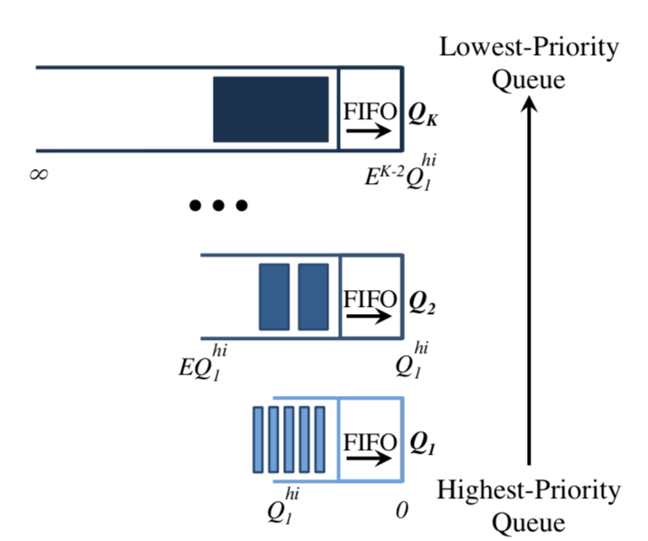
Information-agnostic
Efficient Coflow Scheduling Without Prior Knowledge
M. Chowdhury
SIGCOMM 2015
inter-coflow LAS
Intra-coflow Fair sharing

Slide 10
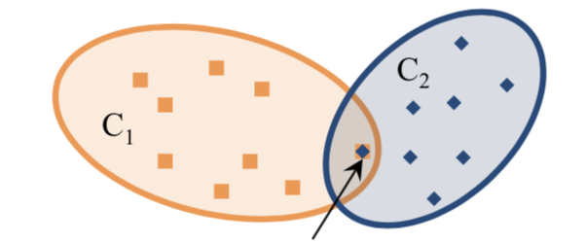
Information-agnostic
CODA: Toward Automatically Identifying and Scheduling Coflows in the Dark
Hong Zhang, Li Chen, Bairen Yi, Kai Chen, Mosharaf Chowdhury, Yanhui Geng
SIGCOMM 2016
inter-coflow LAS
intra-coflow LAS

Slide 11
Information-agnostic
Coflow Scheduling in Input-Queued Switches Optimal Delay Scaling and Algorithms
Qingkai Liang and Eytan Modiano
INFOCOM 2017
O(logN) for probability 1 − O(1/N²)

Slide 12
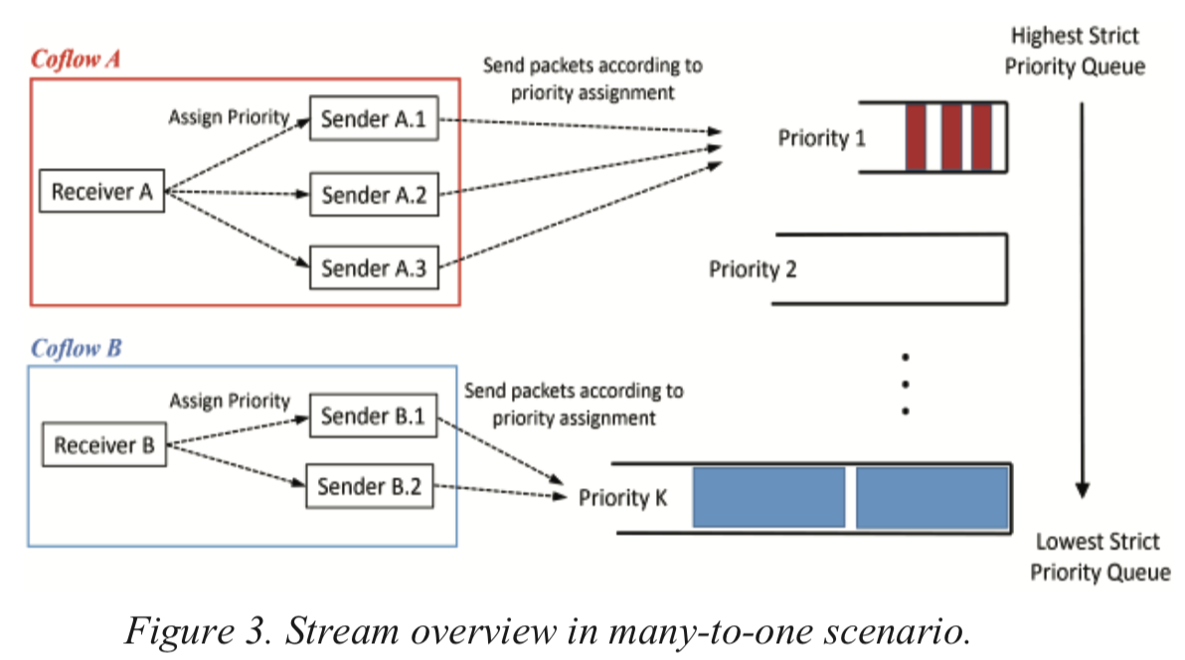
decentralized
Stream: Decentralized Opportunistic Inter-Coflow Scheduling for Datacenter Networks
Hengky Susanto, Hao Jin, and Kai Chen
ICNP 2016
inter-coflow LAS
intra-coflow LAS
Many-one pattern

Slide 13
Multi-stage
Scheduling Coflows of Multi-stage Jobs to Minimize the Total Weighted Job Completion Time
Bingchuan Tian, Chen Tian, Haipeng Dai, and Bingquan Wang
INFOCOM 2018
approximation 2M+1

Slide 14
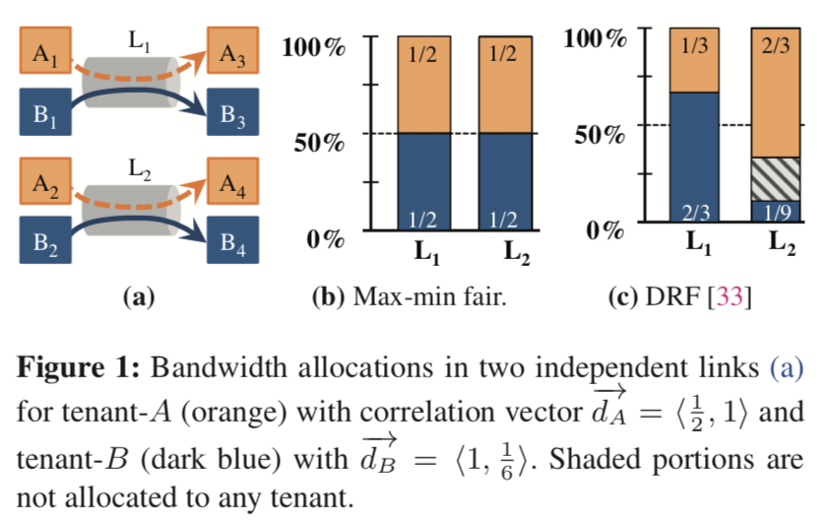
Fairness
HUG Multi-Resource Fairness for Correlated and Elastic Demands
Mosharaf Chowdhury, Zhenhua Liu, Ali Ghodsi and Ion Stoica
NSDI 2016
inter-coflow DRF
intra-coflow fair sharing

Slide 15
Fairness
Optimizing coflow completion times with utility max-min fairness
Li Chen, Wei Cui, Baochun Li, Bo Li
INFOCOM 2016
LP

Slide 16
Information ignostic
Fair Coflow Scheduling without Prior Knowledge
Luping Wang, Wei Wang
ICDCS 2018
Count flow on links
Non-Clairvoyant DRF

Slide 17
both
Coflex Navigating the fairness-efficiency tradeoff for coflow scheduling
Wei Wang, Shiyao Ma, Bo Li, Baochun Li
INFOCOM 2017
a tunable fairness knob

Slide 18
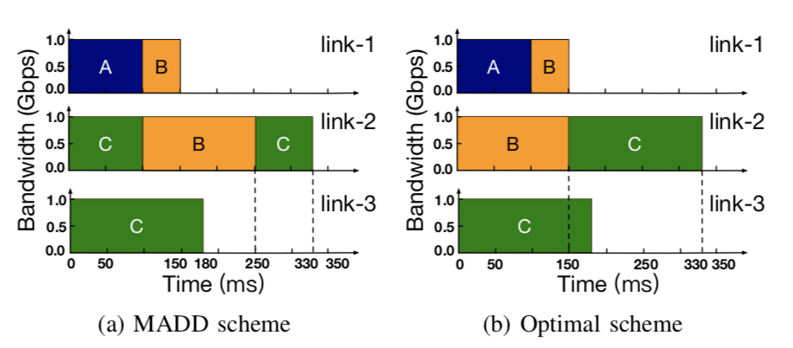
both
Utopia- Near-optimal Coflow Scheduling with Isolation Guarantee
Luping Wang, Wei Wang, Bo Li
INFOCOM 2018
Super-coflow

Slide 19
Thank you !

